Slide 1



PREDICTION OF HOUSEHOLD ELECTRICITY CONSUMPTION
Shahzaib Javed

Slide 2




DEVELOPING MODELS TO PREDICT FUTURE HOUSEHOLD ELECTRICITY CONSUMPTION.AN ORIGINAL
STATEMENT OR
INSPIRING QUOTE TO OPTIMIZE ENERGY USAGE, ENHANCE PLANNING, AND PROMOTE SUSTAINABLE PRACTICES

Slide 3

DATASET DESCRIPTION
Date: Recording date
Time: Recording time
Global_active_power: Total active power (kW)
Global_reactive_power: Total reactive power (kW)
Voltage: Voltage level (V)
Global_intensity: Current intensity (A)
Sub_metering_1: Kitchen consumption (Wh)
Sub_metering_2: Laundry consumption (Wh)
Sub_metering_3: Water heater consumption (Wh)

Slide 4


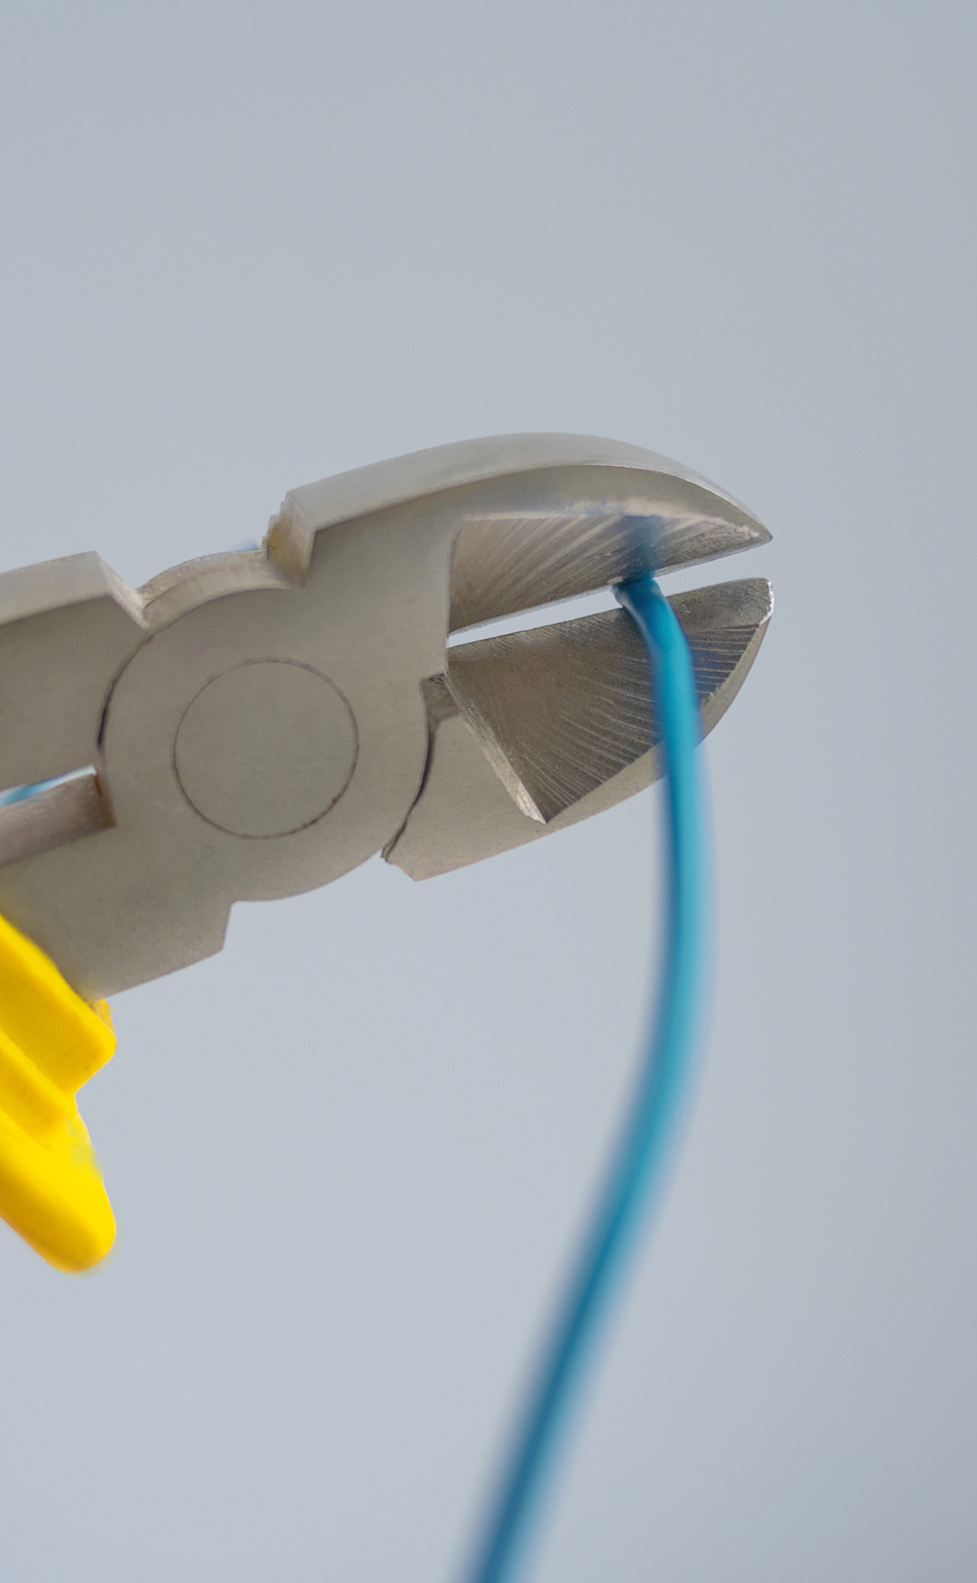
PROJECT OBJECTIVES
Data Preprocessing | Clean data, handle missing values, datetime conversion.
Exploratory Data Analysis: | Identify patterns, trends, and seasonality
Model Implementation: | ARIMA model
Feature Engineering: | Create new features to enhance model accuracy
Future Prediction: | Forecast future electricity consumption

Slide 5






DATA PREPROCESSING
1
2
3
Handle missing values and outliers.
Convert date and time into a single datetime format.
Resample data for daily consumption.

Slide 6
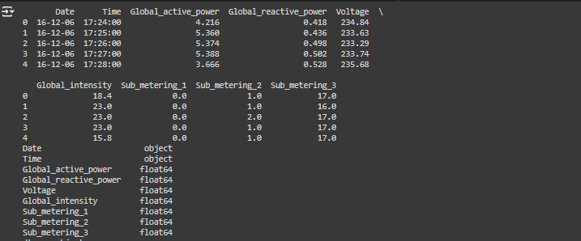

Slide 7

Identified patterns and trends.
Correlation between features
EXPLORATORY DATA ANALYSIS

Slide 8
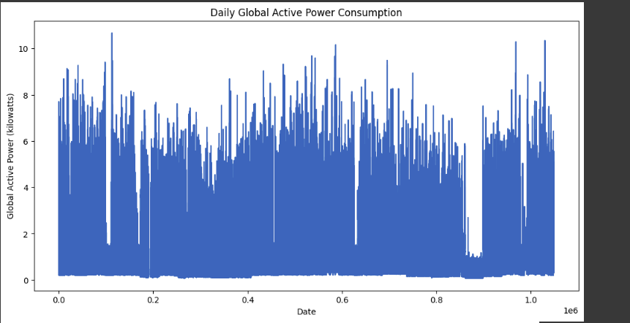
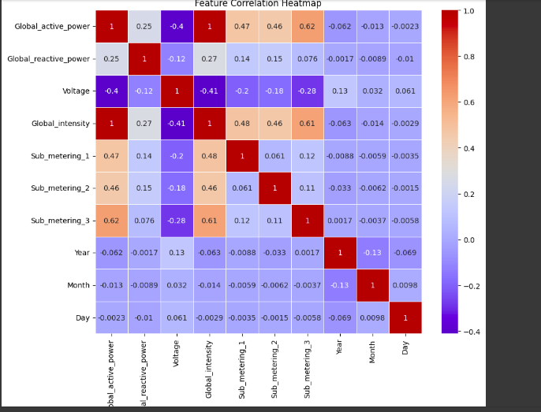

Slide 9


TIME SERIES FORECASTING MODELS
Models Implemented:
ARIMA (AutoRegressive Integrated Moving Average)
SARIMA (Seasonal ARIMA)
LSTM (Long Short-Term Memory)

Slide 10
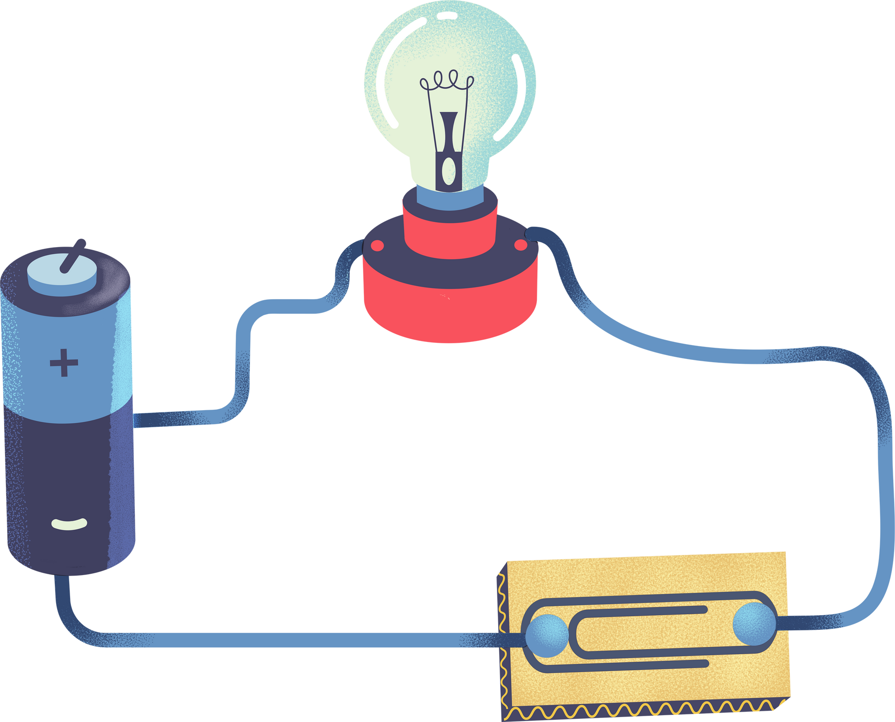

ARIMA MODEL
1
ARIMA for time series forecasting
2
Captures auto-regression, differencing, and moving averages

Slide 11
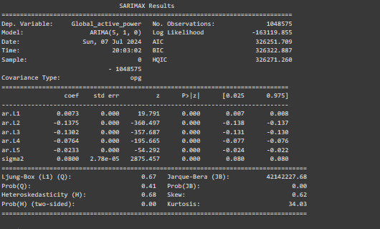

Slide 12
Temporal Features:
Day of the week.
Month of the year.
Year.
Interaction Features:
Interaction between voltage and global intensity.
Lag Features:
Previous days' consumption values
FEATURE ENGINEERING

Slide 13
FUTURE CONSUMPTION PREDICTION
Steps:
Forecasting next 30 days.
Visualization of future trends.
Impact:
Identifying potential consumption patterns.
Assisting in energy management.

Slide 14



THANK
YOU

